Slide 1
IBM University Engagement Project Submission
“Exploring the Power of Machine Learning with IBM Cloud”

Slide 2

Project Title – [AI-Powered Network Intrusion Detection System]
Domain of Project – [ Cybersecurity & AI ]
Student Name | Recent Passport Photo | Email ID | Mobile number [WhatsApp]
Bala Kireeti Dasari |  | balakireeti111@gmail.com | 8523844335
Recommended font style and size: Font Style: Arial Font Size (Heading): 28
Font Size (Content): 20

Slide 3
Problem Statement -
Enhancing Network Security using Machine Learning
The modern digital landscape faces an exponential rise in sophisticated cyber threats targeting enterprise networks. Protecting sensitive data from unauthorized intrusions, such as Denial-of-Service attacks and malware, is a critical priority for organizations. The current security infrastructure relies on traditional detection methods that are often unable to keep pace with evolving attack vectors. Manually monitoring network traffic and identifying anomalies in real-time is a time-consuming and error-prone process. Delays or failures in detecting these intrusions can lead to catastrophic data breaches and systemic compromises. Your task is to design, build, and deploy a robust, intelligent classification model that can accurately predict and identify network anomalies based on real-time traffic data. The goal is to create a reliable, high-performance security tool that assists administrators in quickly and accurately detecting intrusions, ensuring network integrity and data protection are maintained efficiently.

Slide 4
Proposed Solution -
(AI & Machine Learning Infrastructure):
Intelligent NIDS Architecture: We leverage Watson Studio to develop our model, utilizing Watson Machine Learning for scalable deployment and inference, supported by watsonx.governance to ensure reliability and model performance.
Data Processing: The system processes key network attributes—including src_bytes, duration, protocol type, and flags—normalizing them for secure, asynchronous API transmission to our hosted model.
Model Logic: By leveraging automated pattern recognition, the model distinguishes between standard traffic and malicious intrusions, significantly reducing manual monitoring overhead.
Actionable Output: The system delivers immediate binary classification (‘Normal’ vs. ‘Anomaly’), providing administrators with critical insights to mitigate threats before network integrity is compromised.

Slide 5
Technology Used
IBM Cloud – It provides the infrastructure to build, deploy, and scale the Network Intrusion Detection System (NIDS) efficiently. IBM Cloud enables a reliable, secure, and scalable environment for deploying the NIDS agent.
ML Algorithm/ Model Used: Decision Tree Classifier (trained and deployed via Watson Machine Learning).
Accuracy Obtained: 99.8%
Enhancements and Hyperparameter tuning: Automated optimization via AutoAI in Watson Studio, including feature selection and parameter configuration to maximize classification performance.

Slide 6
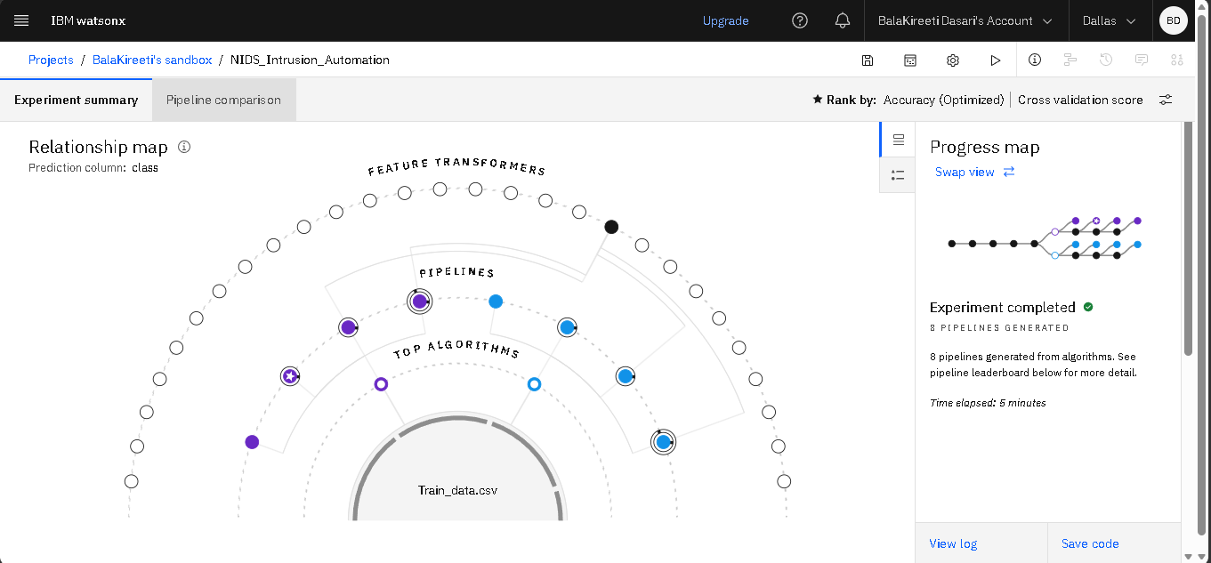
Training Screenshots-

Slide 7
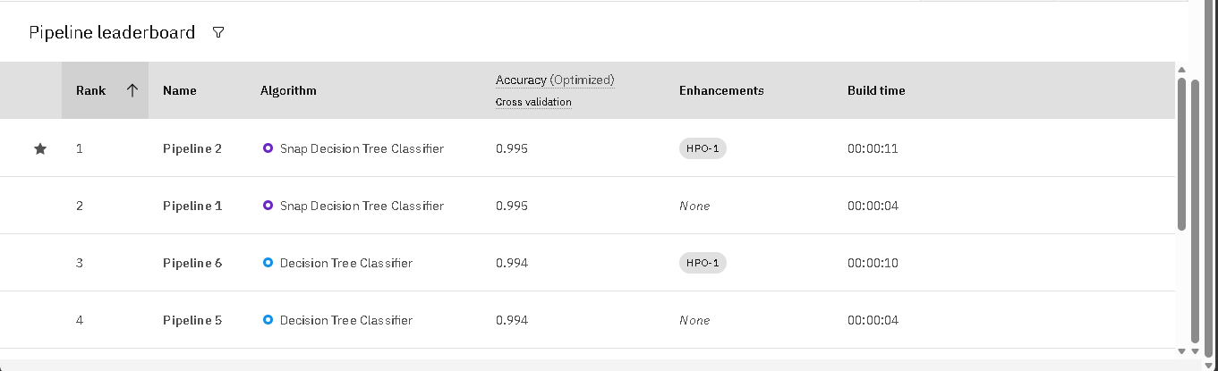
Best Model Screenshot:

Slide 8
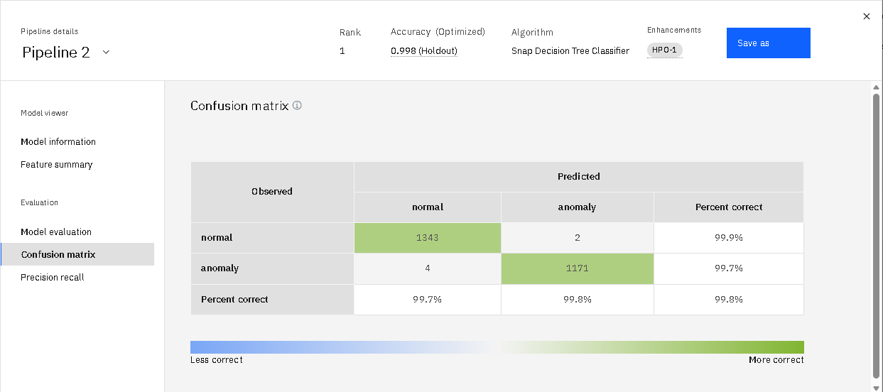

Slide 9
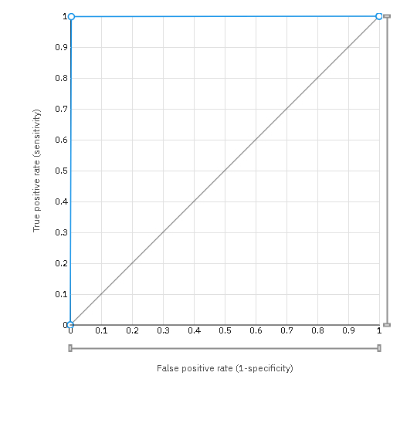
ROC Curve (of PIPELINE 2):

Slide 10
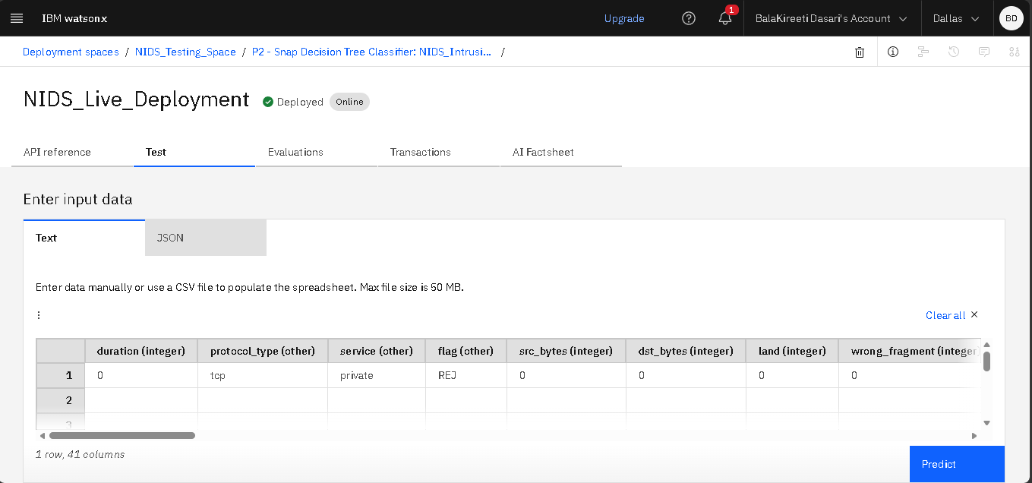
Testing Screenshot:
Input:

Slide 11
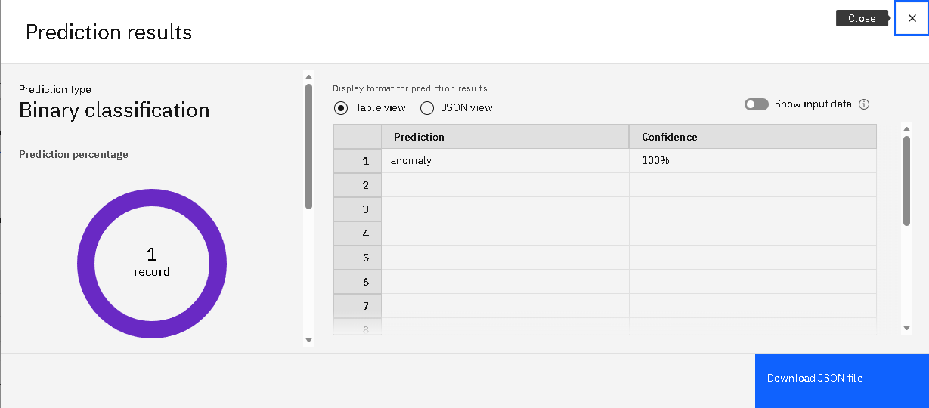
Output:

Slide 12
Novelty and Uniqueness
The solution automates network intrusion detection, significantly reducing manual monitoring efforts and incident response time.
It leverages IBM watsonx.ai AutoAI to automatically discover and optimize the best-performing machine learning model for traffic classification without extensive manual coding.
The system accurately classifies real-time network traffic into 'Normal' or 'Anomaly' categories through a single, intelligent, and integrated platform.
Automated feature engineering helps identify hidden patterns in complex, high-volume network telemetry data, improving detection accuracy.
The model ensures consistent and unbiased threat identification, minimizing human errors and subjective security decisions.

Slide 13
Git Hub Link
https://github.com/Kireeti111975/NIDS
·
·
·

Slide 14
Future Scope
The system can be integrated directly with enterprise firewalls and SIEM tools to automate real-time, end-to-end network threat response.
Additional attack datasets and behavioral signatures can be included, enabling a more robust, multi-layered AI-based intrusion detection platform.
Real-time integration with global threat intelligence feeds can improve predictive accuracy and enhance the identification of zero-day exploits.
Advanced AI models in IBM watsonx.ai can be used to continuously retrain the system, ensuring detection accuracy evolves alongside emerging cyber-attack patterns.
The solution can be scaled for enterprise-wide deployment to provide faster, proactive, and data-driven security monitoring across complex network infrastructures.
·
·
·

Slide 15
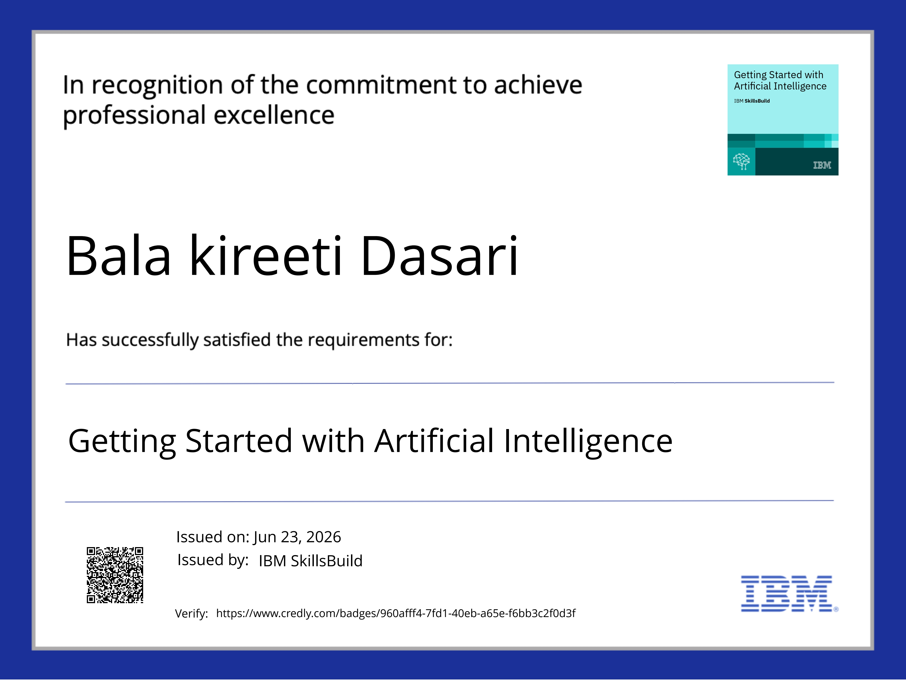
Certificates Earned:

Slide 16
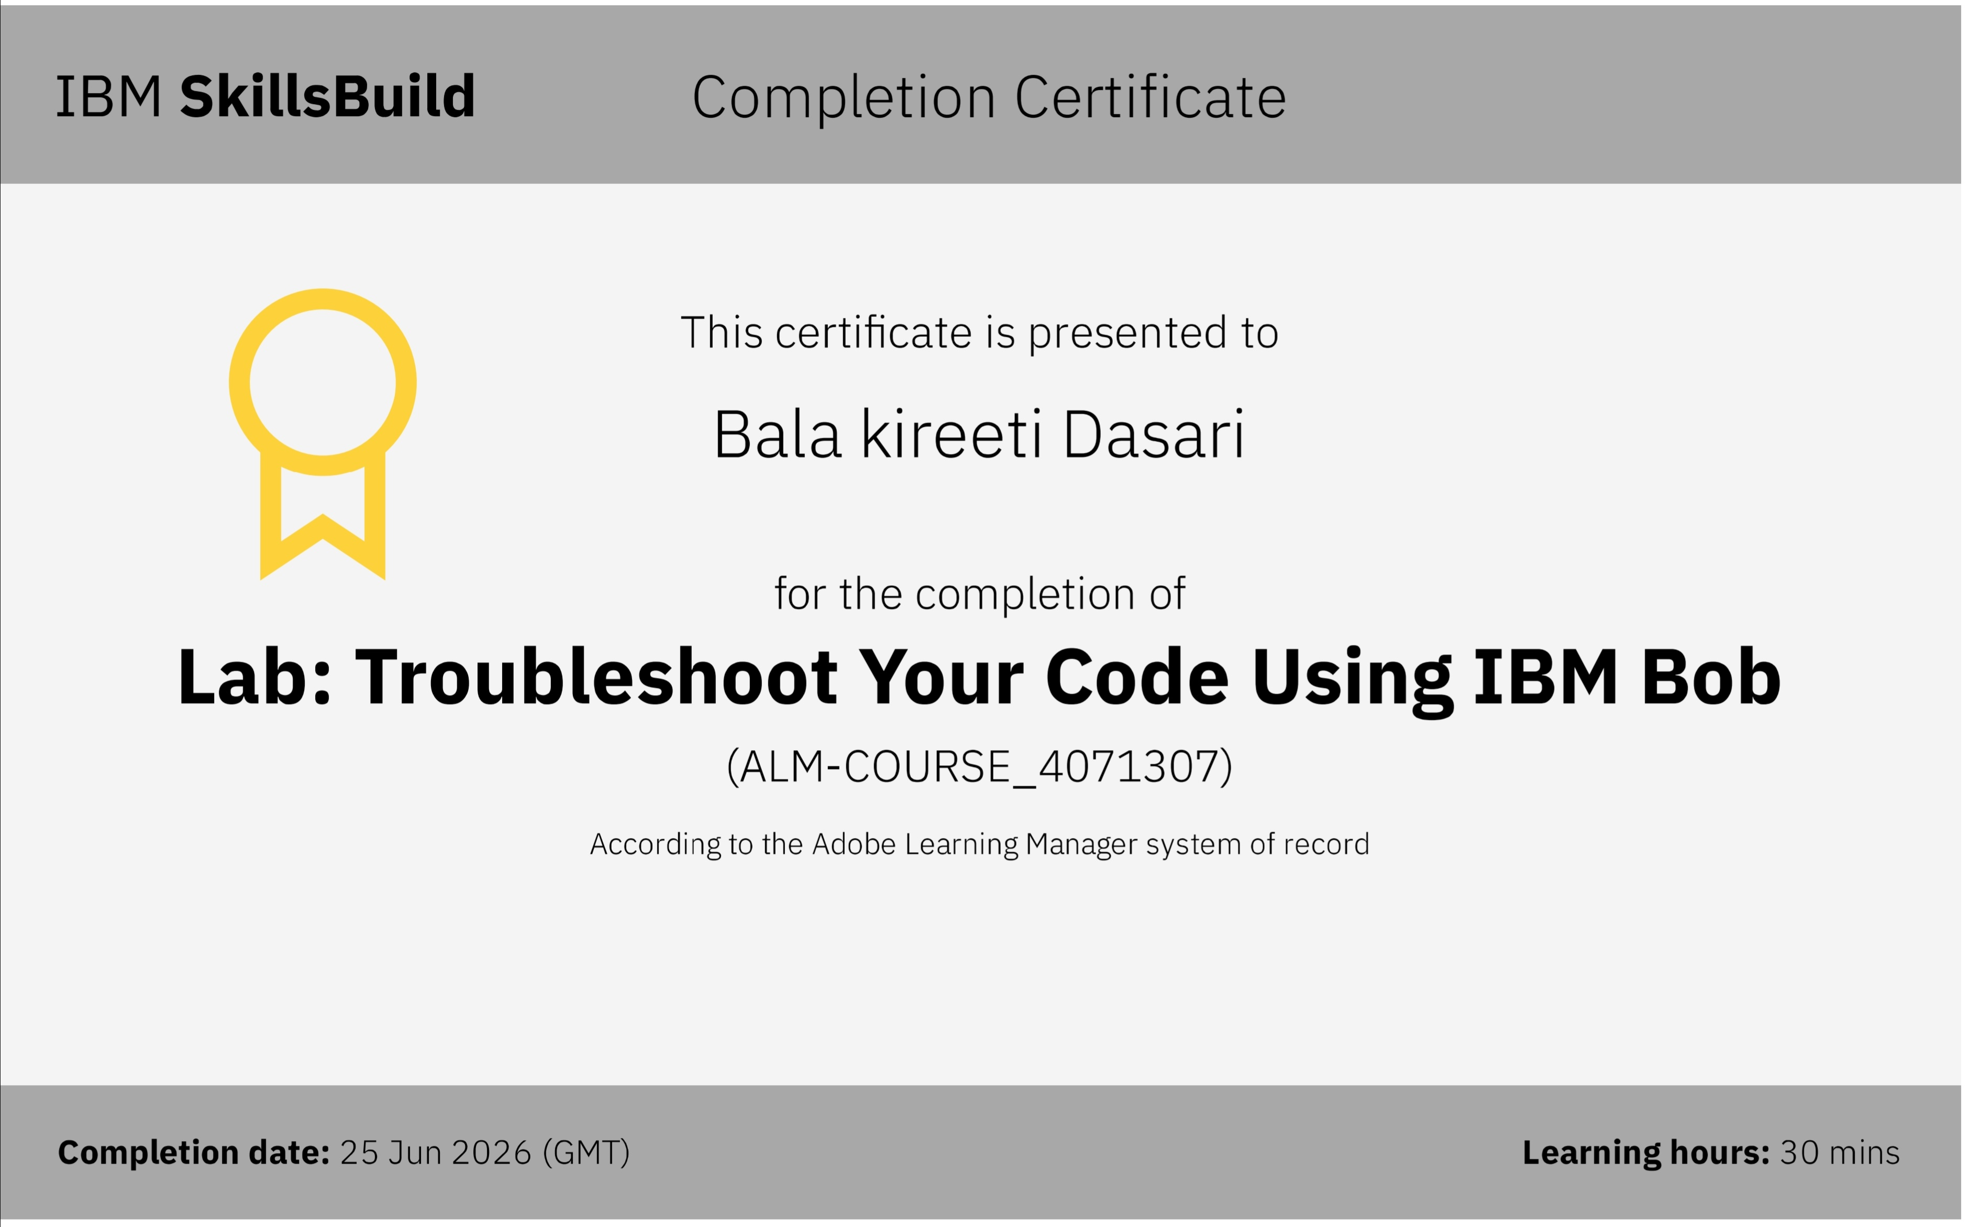
Certificates Earned:​

Slide 17


